Slide 1
Full Structural Models
Kline Chapter 10
Brown Chapter 5 (157-211)

Slide 2
Full SEM
You have to have:
Measurement model: the CFA part
Structural part: the relationship between the latents

Slide 3
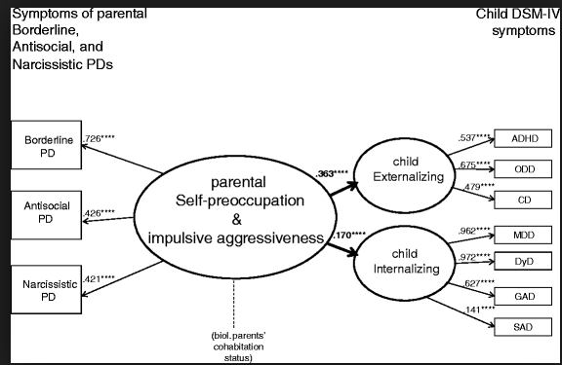

Slide 4
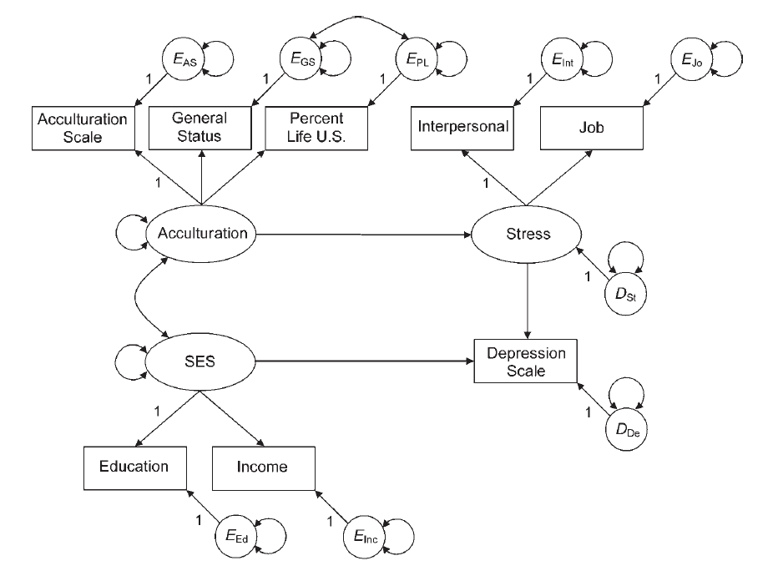

Slide 5
Full SEM
Reminder:
Reflective indicators / effects indicators
We assume factors cause the indicators, so the arrows go out.
Formative indicators / cause indicators
When we use items to predict a latent (arrows go into the latent).

Slide 6
Full SEM
Example of formative indicator
Income, education level, and occupation all predict your SES
Stress caused by outside factors
Other names:
Composite causes
MIMIC – multiple indicators, multiple causes models

Slide 7
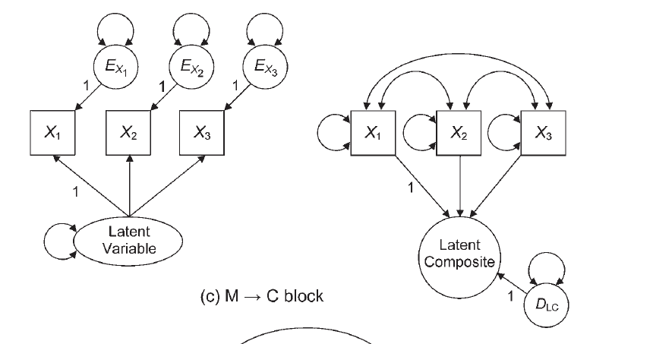

Slide 8
Measurement Model Identification Reminder
Identification rules of thumb:
Latent variables should have four indicators
Latent variables have three indicators AND
Error variances do not covary
Latent variables have two indicators AND
Error variances do not covary
Loadings are set to equal each other.

Slide 9
Structural Model Identification
Scaling is also required to identify the structural part
2+ emitted paths rule
Composite variable must have have direct effects on two other endogenous variables

Slide 10
Things to Consider
Parceling
When you have large structural models, they can be very complex to fit to a Full SEM if each latent variable has lots of indicators (items).
Parceling occurs when you creating subsets of items to be able to get the model to run and to balance out the number of indicators on each latent.

Slide 11
Things to Consider
Parceling
At the moment, this topic is still pretty controversial. Many fall into the: this is bad don’t do it camp.

Slide 12
Things to Consider
How to model?
Test each CFA piece separately to make sure they run.***
Slowly add structural paths to see if you can get the full model to work.
If not, try parceling.
Drop non-significant paths.
***if your CFA is bad, the full model will be bad too.

Slide 13
Things to Consider
As you add the structural components, you should not see a big change in the loadings to the indicators
If you do, it means the model is not invariant (a fancy word for doesn’t change)
Called interpretational confounding

Slide 14
When to Stop?
We’ve discussed lots of tricks to explore models and improve them.
When do you quit?
Based on theory
Fit indices do not greatly improve
Parsimony

